Slide 1

IS 7034 Group Project Final Scikit-Learn
Group CRVSS Chris Cardone
Ryan Brinkman
Vibhash Dhar
Shruthi Ramesh
Scott Steehler

Slide 2


Business Case
We are a small brick and mortar movie rental store
Losing customers to businesses with larger technical capabilities
Feel we can outperform larger companies in customer service
Establish ourselves as a community and not just a rental store
Blockbuster
Family Video
Hollywood Video
US?

Slide 3
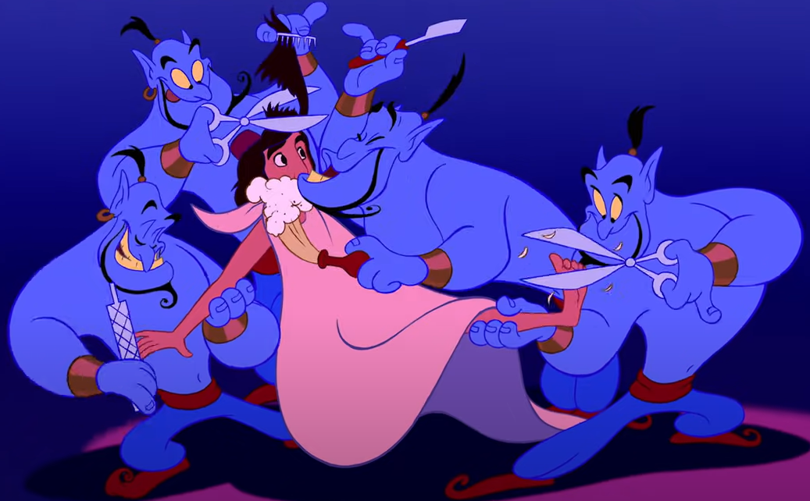
Proposed Solution
Build a recommendation application to help cater to our customer's preferences
All the major tech companies do this
Netflix estimates its recommender is worth $1 billion annually¹
Protentional benefits
Increased number of orders and order size
Automated advice
Guidance for adding to inventory
1 - Mcalone, Nathan. “Why Netflix Thinks Its Personalized Recommendation Engine Is Worth $1 Billion per Year.” Business Insider
Notes:
According to Business Insider Netflix data suggests it has 60-90 seconds of people’s attention looking for movies
Netflix estimates only 20% of stuff watched comes from searches, other 80% recommended
Automated advice – helps for when employees do not know a lot about a particular genre
Guidance for adding to inventory – If a group of new customers is now interested in a genre that we do not have a lot of, the recommended could help us figure out what titles to purchase

Slide 4
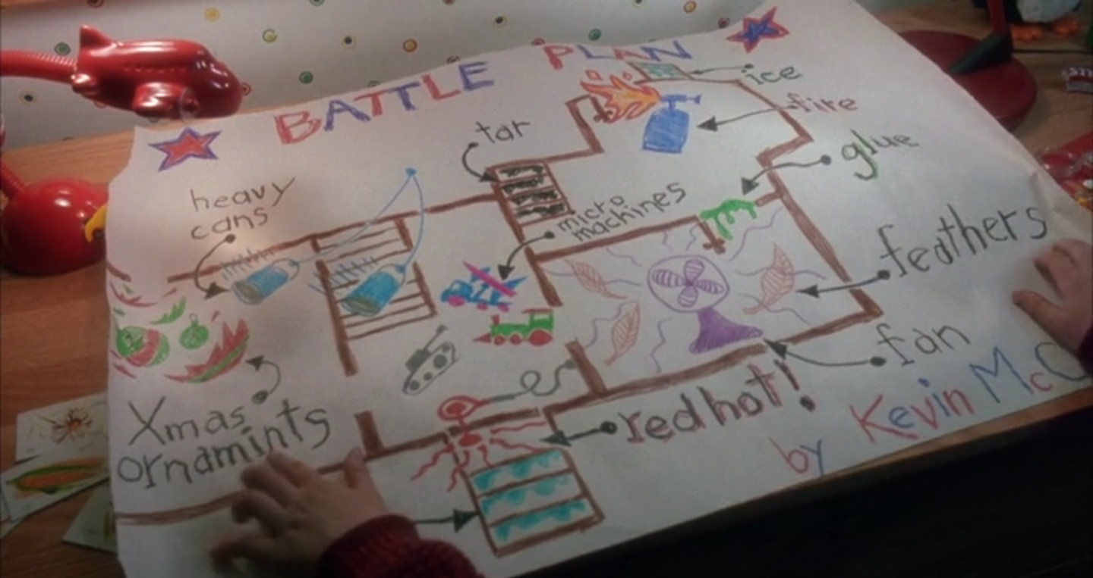
Constraints & Desired Features
Constraints
Limited budget to spend on software
Limited existing computer hardware capabilities
Limited technical knowledge of staff
Desired Features
Free
Easy to use & understand
Existing commands / infrastructure
Quick results
Customizable
Operational by anyone

Slide 5
Scikit-Learn
Free software machine learning library for Python²
Started in 2007 as a Google Summer of Code project
Released to public in 2010 2
Scikit-Learn application categories listed in the user guide
Supervised Learning
Unsupervised Learning
Model Selection and Evaluation
Inspection
Visualizations
Dataset Transformations
Dataset Loading Utilities
Advanced Computational Methods (handle large datasets)
Model Persistence (save machine learning module)
2 Scikit-learn: Machine Learning in Python, Pedregosa et al
Notes:
Any computer than can run Python and can handle a large database can run Sci-kit learn This software is may help us achieve our goal because it allows for machine learning thus will allow for creation of a recommender. In addition, it meets the desired features of being free, having existing commands and infrastructure, and customizable.
The main features we will be utilizing with this software is unsupervised learning (nearest neighbor) and other scikitlearn commands (sklearn.feature_extraction.text & sklearn.metrics.pairwise )

Slide 6







Companies Using Scikit-Learn²
J.P. Morgan & BNP Paribas Cardif
Spotify
Booking.com
Change.org
OkCupid
Mars
2 Scikit-learn: Machine Learning in Python, Pedregosa et al
Notes:
Financial institutions like J.P. Morgan & BNP Paribas Cardif use Scikit Learn for classification
Media company Spotify use Scikit Learn for music recommendations
Accommodation website Booking.com use Scikit Learn for detecting fraud, scheduling agents, and recommending hotels and destinations
Activism websites Change.org use Scikit Learn to drive email targeting
Relationship social media sites OkCupid use it to evaluate and improve matchmaking
Food manufacturing company Mars rapidly prototyping and taking to new food recipes to production

Slide 7
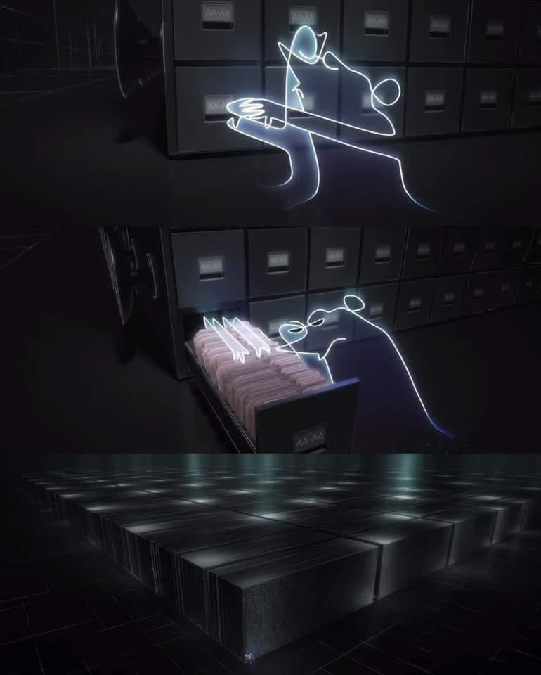
Dataset
Dataset downloaded from Kaggle which took gathered data from MovieLens⁸
The Dataset contains 27k + movies with 20 million + ratings and 465k + tag applications.
The data is contained in 6 excel files
Tag.csv
Rating.csv
Movie.csv
Link.csv
Genome_tags.csv
Genome_scores.csv
8 F. Maxwell Harper and Joseph A. Konstan. 2015. The MovieLens Datasets: History and Contex
Notes:
Tag.csv contains users created tags
Rating.csv contains user ratings
Movie.csv contains movie information
Link.csv contains identifiers for outside sources
Genome_tags.csv contains tag descriptions
Genome_scores.csv contains tag descriptions
For our business purpose we focused on the movie and rating tables
Movie table contains title, year, and genre data
Rating table contains scores from a large number of reviews by consumers

Slide 8

Tutorial – General Steps
Install Python
Install Scikit-learn package
Download movie dataset
Import dataset in Python
Clean dataset
Vectorize genres using TF-IDF
Calculate cosine distances
Use nearest neighbor to find closest matches
Review results and make and changes as needed
Write function so that all that is needed is the title and the year to get 10 recommendation titles & genres

Slide 9
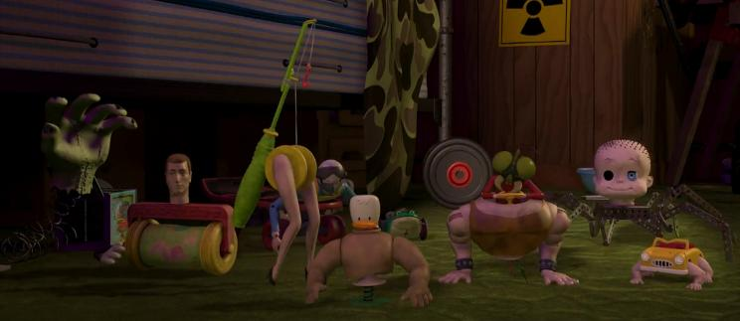
Recommender Systems^{3,4}
Content-based filtering
Based on characteristics of entries
Does not require user feedback
Collaborative filtering
Requires users’ historical ranking of a group of items
Does not require entry characteristics
Hybrid Filter
Combines both
3 Roy, Abhijit. “Introduction To Recommender Systems- 1: Content-Based Filtering And Collaborative Filtering.”
4 Leban, Jonathan. “Essentials of Recommendation Engines: Content-Based and Collaborative Filtering.”
Notes:
There are many types of recommender systems. We have the Content-based filtering system and collaborative filtering systems, hybrid recommender system. There are other types of recommender systems as well, but we have focused on these filtering systems in our project.
Content-Based filtering : Content-based filtering methods are based on a description or characteristics of the item. We are considering a movie that a user currently likes/ has recently watched as input. Based on this input, we are analyzing the genre of the movie to find out other movies which have similar content. We are ranking these movies by calculating the similarity scores of these movies.
Collaborative filtering : The main idea behind Collaborative filtering is to use other users’ preferences or ratings to recommend new items to a user. The usual procedure is to find similar users (or items) to recommend new items which were liked by those users. In our case we are finding movies that have a similar rating as the input movie to recommend other movies to customers.
Hybrid : Includes techniques combining collaborative filtering, content based and other possible approaches. Nowadays most recommender systems are hybrid. We are using a hybrid approach in our project to make movie recommendations. First we are doing a content-based filtering using genres of the movies and using the output to do a collaborative filtering to get the final movie recommendations.

Slide 10
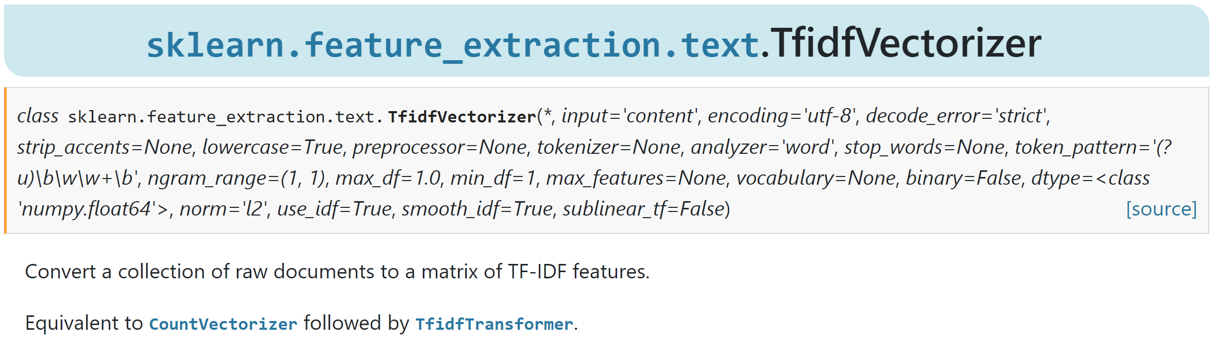
TF-IDF Vectorizer^{5,6,9}
TF-IDF is a measure that assesses how relevant a word is to an entry in a collection of entries
The idea is to reduce the importance of common words throughout the dataset (the, is, in, etc) while focusing on the uniqueness of others
A word common across many entries has a lower value
Used for organizing genres
5 What Is TF-IDF?” MonkeyLearn Blog
6 Ganesan, Kavita. “How to Use Tfidftransformer & Tfidfvectorizer - A Short Tutorial.”
9 Scikit-Learn Documentation
Notes:
We are using a TF-IDF Vectorizer.
Term Frequency- Inverse Document Frequency
TF is the frequency of a word in particular entry
IDF is the inverse of the word frequency in the corpus of entries
So, the main idea behind the TF-IDF is to dampen the effect of high-frequency words in determining the importance of an item. The fewer movies that contain a given genre, the higher the resulting weight. The TF-IDF vectorizer is used to vectorize the genres. Vectorization helps to implement ML models on text-based features. In simple terms, TF-IDF vectorizer converts strings into vectors based on their frequency. Words with higher frequency are penalized, this helps in segregating the important words from connecting words like 'the', 'is', 'in' etc.
Some of the parameters of the TF-IDFVectorizer function are :
Analyzer – indicates whether the feature should be made of word or character n-grams. Ngram is a string of elements such as letters or words that appears within a longer sequence.
ngram_range – indicates the lower and upper boundary of the range of n-values for different n-grams to be extracted.
Min_df - When building the vocabulary ignore terms that have a document frequency strictly lower than the given threshold.
Stop_words – if the parameter is a string, it is passed to _check_stop_list and the appropriate stop list is returned. ‘english’ is currently the only supported string value.

Slide 11
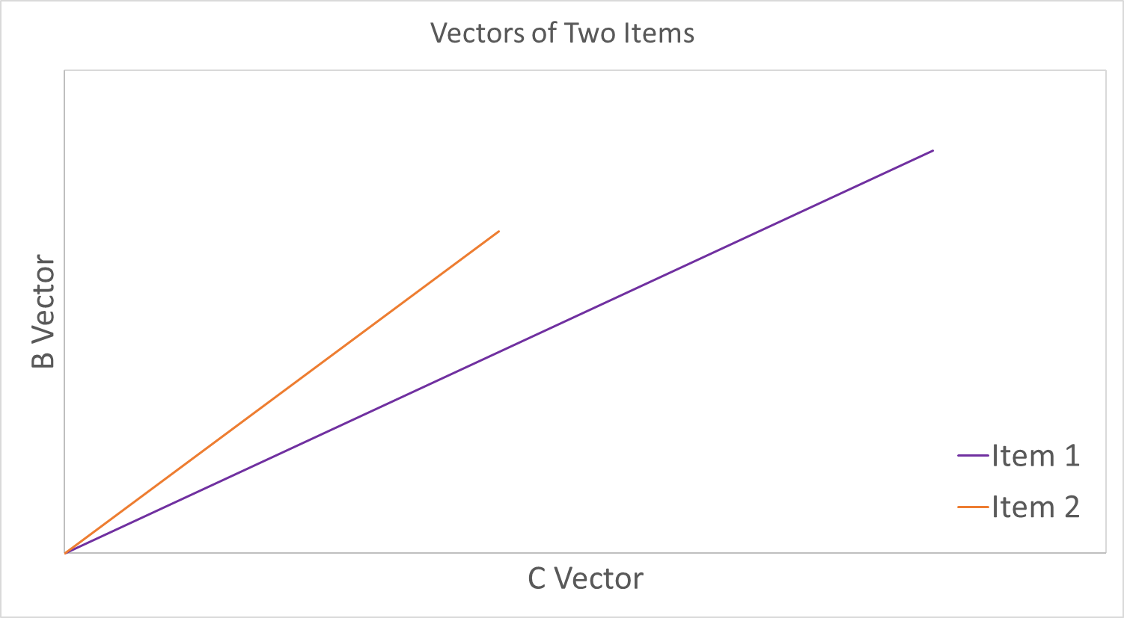

Cosine Similarity^{7,9}
Used to calculate similarity scores
This method compares the distance between vectors
For this type of example:
B vector, classified as the profile vector, contains all the past ratings and tags given to the movie by other users
C Vector, classified as an item vector, which contains all the description data of the movies such as name, genre, cast, runtime, cast, etc.
(B₁,C₁)
(B₂,C₂)
7 Kurka, Bernard. “Building Movie Recommender Systems Using Cosine Similarity in Python.” Medium
9 Scikit-Learn Documentation
Notes:
Cosine Similarity:
Used to calculate similarity
Compare the cosine distance between vectors
We are creating a genre-matrix and then we are calculating the similarity scores for the movies using the genre-matrix using the linear_kernel function in Scikit-Learn. Scikit-Learn comes with a cosine-similarity module but in our case since we have used the TF-IDF vectorizer, calculating the dot product between each vector will directly give you the cosine similarity score. We are doing this because linear_kernel function is much faster than the cosine-similarity function.
Based on the similarity scores, the movies we are getting a list of 100 movies.

Slide 12
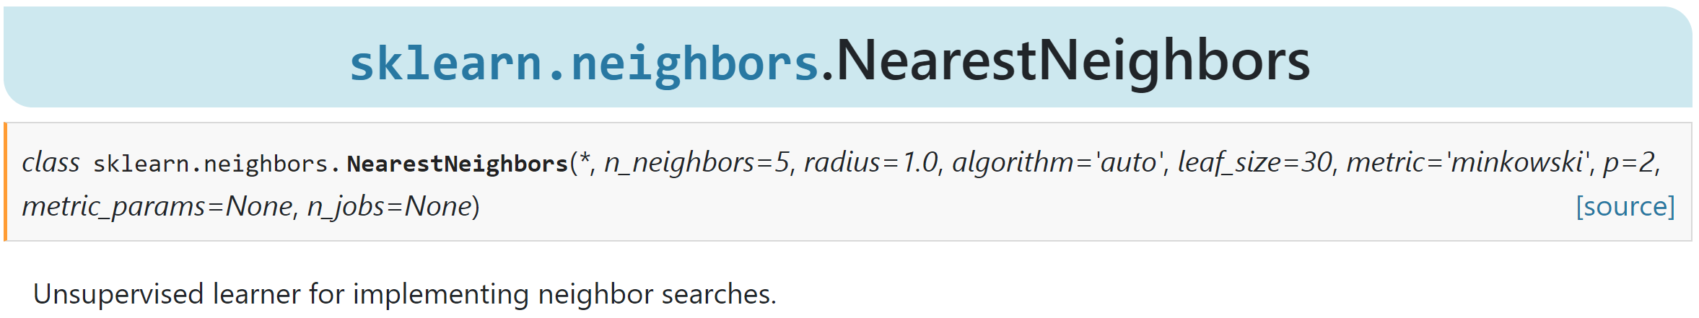
Nearest Neighbors
Used to find the nearest neighbors for each movie.
It includes the movie itself.
Number of neighbors to be considered can be mentioned
9 Scikit-Learn Documentation
Notes:
Now, we use Nearest-Neighbors function in Scikit-Learn to do a collaborative filtering. NearestNeighbors implements unsupervised nearest neighbors learning.
This is available in the Neighbors module in Sklearn.
Some of the parameters for nearest neighbor function are:
n_neighbors – indicates the number of neighbors to use
algorithm - Algorithm used to compute the nearest neighbors. We have different algorithms such as ‘Ball_tree’, ‘kd_tree’, ‘Brute-force’, and ‘Auto’ which will attempt to decide the most appropriate algorithm based on the values passed to fit method.
Metric – indicates the distance metric to use for the tree.
n_jobs - The number of parallel jobs to run for neighbors search. None means 1. -1 means using all processors.

Slide 13
Demonstration

Slide 14
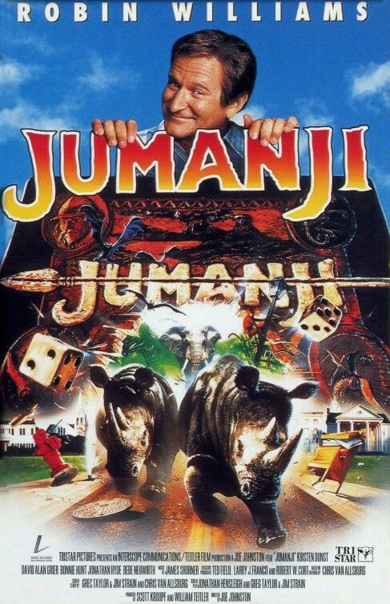

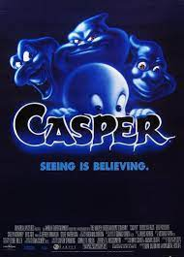
First Results – Collaborative vs Hybrid
Notes:
Initial model produced results that raised questions about applicability, specifically with Jumanji
Note that none of the recommendations share any genres in common with the input movie
These results indicated that the model needed to be reworked and integrating genre data was proposed
Initial model was also demanding on CPU/GPU
Utilizing a TF-INF vector solved this problem by prioritizing unique genres in results

Slide 15
Results – Children Genres
Notes:
Hybrid model prioritizes movies that share genres
In most cases, the recommendations share all or a subset or the input's genres
Occasionally, they include genre's outside of the input (ex. Frozen with outputs that have IMAX

Slide 16

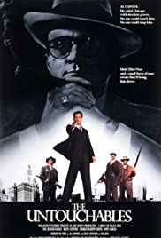


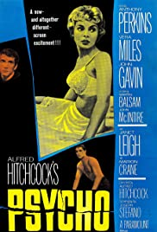

Results – Gangster, War, Horror
Notes:
Genres that frequently appear together can significantly impact recommendations
Ex. Scarface and Saving Private Ryan- all recommendations share the same genres
This does raise potential questions about if genres has too much influence in the model

Slide 17






Results – Cult, Romance, Musical
Notes:
Casablanca
All outputs share the same genres
While date is not a variable in the model, there is a significant release year difference between the input and output where most movie's are 50 years newer
Chicago
Potential issue since none of the recommendation share the musical genre
Grouping of Comedy, Crime, and Drama is common in the dataset

Slide 18
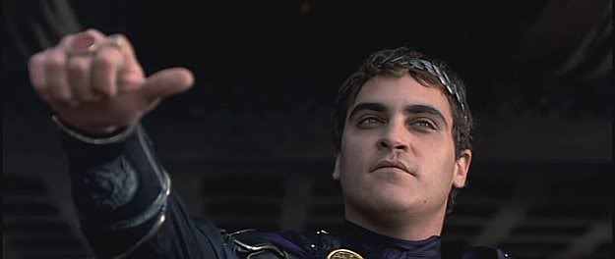
Do We Recommend? Yay or Nay
Recall constraints and desired features
Free ✓✓✓
Hardware requirements ✓✓
Easy to use & understand ✓✓
Existing commands / infrastructure ✓✓✓
Quick Results ✓✓✓
Customizable ✓✓✓
Notes:
With the streamlined code newer computers can build the machine learning function in a matter of minutes. This will not have to be done every day but only after new data is entered into the system
Once the function is complete, it takes a matter of seconds to get a results
Flexibility allows for future improvements and changes to the model
Add year of release
Include internal specific data (ex. Number of copies available in store, order a copy to be shipped to you)

Slide 19
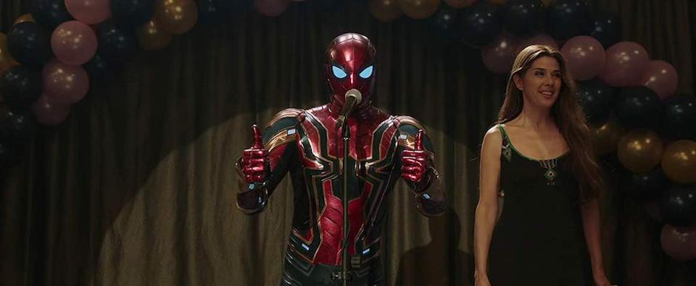
Yay
Met all our requirements
The results of the run seemed appropriate
The database can be expanded upon and customized for our database
Simple implementation even for a small business
Recommend a focused multistep implementation process
Notes:
Appropriate Results
V2 of function(hybrid model) provided output that are inline with common sense expectations
Expansion and future development
Additional variables can be added to the model with relative ease
Ease of implementation for small business
Function outputs a simple list of recommended movies that can be integrated into any system
Black box model that does not require significant machine learning background or any interpretation
Example of implementation process
Install software and implement code
Load only the most popular movies in database first or select genres to reduce database size and computational effort
Implement program with customers and gauge interest
If interest is high and the program is positively received increase efforts by expanding database and maybe getting some outside help

Slide 20

Alternatives
TensorFlow
PyTorch
R
Companies such as Google, Facebook, Uber and Airbnb use these software extensively for their research and production needs.
Notes:
As Scikit-learn is a Machine Learning package there are other libraries that are relevant to what we want to achieve.
TensorFlow
Developed by Google
Currently being used by Google. Coca Cola, Intel, Twitter, GE Healthcare and Airbnb as a part of their research and production needs.
Useful in deep learning projects
Mostly used to create Neural Networks
PyTorch
Developed by Facebook
Currently being used in Facebook, Tesla Autopilot & Uber's Pyro
Used at Salesforce, Stanford and Udacity for research on new algorithmic approaches
Can work on CPU or GPU and provides accelerated Tensor computing.
BOTH
Both TensorFlow and PyTorch are compatible with scikit-learn and can be used to implement complex neural networks with the simplicity of sklearn.
R
Statistical Software used by Statisticians and econometricians for research & model building.
Same models that can be built in Python can be built in R
Requires significantly more code since fewer packages/libraries exist for recommendation systems
Being used at Facebook for behavior analysis, at Google for economic forecasting, at ANZ for credit-risk modeling & at Uber for statistical analysis.

Slide 21
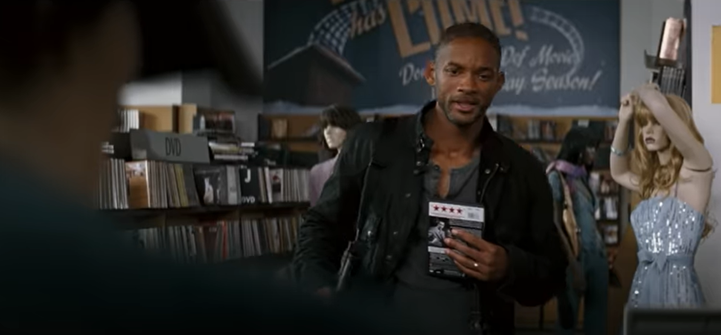
Final Conclusions
Sci-kit learn is a free machine learning library from Python that can be used to easily create a hybrid recommender
A simple tool to implement with limited Python knowledge
Create unique recommender with customizable datasets and code to tailor it to a particular customer base
Future Developments:
Add Actors, Directors, Reviews etc. into the model.
Account for user's watching history, time and other details to personalize the suggestions
Notes:
Sci-kit learn is a free machine learning library from Python that can be used to easily create a hybrid recommender
Limited Python knowledge is needed
There are many free resources available to learn about python and specifically for building recommender models
Customizable datasets and code can make for a unique recommender
The general structure of our tool could be adapted to other businesses
It is a simple tool to implement to try and build customer relationships
Model only needs to be re-built if new movies or rating are added. This could be scheduled to occur during low traffic off hours
In terms of future development:
Model can be rebuilt to include more variables such as Actors, Directors, Movie Tags, Reviews. This will allow for suggestions to be more diverse.
Model can be made to account for user's watching history while suggesting more movies.

Slide 22
References
Mcalone, Nathan. “Why Netflix Thinks Its Personalized Recommendation Engine Is Worth $1 Billion per Year.” Business Insider, 14 June 2016, www.businessinsider.in/Why-Netflix-thinks-its-personalized-recommendation-engine-is-worth-1-billion-per-year/articleshow/52754724.cms.
Scikit-learn: Machine Learning in Python, Pedregosa et al., JMLR 12, pp. 2825-2830, 2011.
Roy, Abhijit. “Introduction To Recommender Systems- 1: Content-Based Filtering And Collaborative Filtering.” Medium, Towards Data Science, 31 July 2020, towardsdatascience.com/introduction-to-recommender-systems-1-971bd274f421.
Leban, Jonathan. “Essentials of Recommendation Engines: Content-Based and Collaborative Filtering.” Medium, Towards Data Science, 21 May 2020, towardsdatascience.com/essentials-of-recommendation-engines-content-based-and-collaborative-filtering-31521c964922.
“What Is TF-IDF?” MonkeyLearn Blog, 10 May 2019, monkeylearn.com/blog/what-is-tf-idf/.
Ganesan, Kavita. “How to Use Tfidftransformer & Tfidfvectorizer - A Short Tutorial.” Kavita Ganesan, Ph.D, 6 Aug. 2020, kavita-ganesan.com/tfidftransformer-tfidfvectorizer-usage-differences/#.YL1mWflKiUk.
Kurka, Bernard. “Building Movie Recommender Systems Using Cosine Similarity in Python.” Medium, 30 June 2019, medium.com/@bkexcel2014/building-movie-recommender-systems-using-cosine-similarity-in-python-eff2d4e60d24.
F. Maxwell Harper and Joseph A. Konstan. 2015. The MovieLens Datasets: History and Context. ACM Transactions on Interactive Intelligent Systems (TiiS) 5, 4, Article 19 (December 2015), 19 pages. DOI=http://dx.doi.org/10.1145/2827872
scikit-learn: machine learning in Python — scikit-learn 0.24.2 documentation

Slide 23
Images
“Days Gone By”. The Walking Dead. AMC. October 31, 2010. Television
“Aladdin” Dir John Musker & Ron Clements. Perf. Scott Weinger, Robin Williams & Linda Larkin. Walt Disney Pictures, 1992. Film
“Home Alone” Dir Chris Columbus. Perf. Macaulay Culkin, Joe Pesci, & Daniel Stern. 20th Century Studios, 1990. Film
“The Simpsons Movie” Dir David Silverman. Perf. Dan Castellaneta, Julie Kavner, Nancy Cartwright, Yeardley Smith,. 20th Century Studios, 1990. Film
“Soul” Dir Pete Docter & Kemp Powers. Perf. Jamie Foxx & Tina Fey. Walt Disney Pictures, 2020. Film
“Toy Story” Dir John Lasseter. Perf. Tom Hanks & Tim Allen. Walt Disney Pictures, 1995. Film
“Matrix Reloaded” Dir Lana and Lilly Wachowski. Perf. Keanu Reeves, Carrie-Anne Moss & Lawrence Fishburne. Village Roadshow Pictures, 2003. Film
“The Hangover” Dir Todd Philips. Perf. Zach Galifianakis, Bradley Cooper, & Daniel Stern. Legendary Pictures, 2009. Film
“Gladiator” Dir Ridley Scott. Perf. Russel Crowe & Joaquin Phoenix. DreamWorks Pictures, 2000. Film
“Spider-Man Far From Home” Dir John Watts. Perf. Tom Holland, Jake Gyllenhaal, & Zendaya. Columbia Pictures, 2019. Film
“I am Legend” Dir Francis Lawrence. Perf. Will Smith. Warner Bros Pictures, 2007. Film
“JUMANJI.” JUMANJI | Sony Pictures Entertainment, www.sonypictures.com/movies/jumanji.
“'Til There Was You.” IMDb, IMDb.com, 30 May 1997, www.imdb.com/title/tt0118523/.
“Casper” IMDb, IMDb.com, 26 May 1995 https://www.imdb.com/title/tt0112642/
“ “Scarface.” IMDb, IMDb.com, 9 Dec. 1983, www.imdb.com/title/tt0086250/.
“The Untouchables.” IMDb, IMDb.com, 3 June 1987, www.imdb.com/title/tt0094226/.
“Saving Private Ryan.” IMDb, IMDb.com, 24 July 1998, www.imdb.com/title/tt0120815/.
“Apocalypse Now.” IMDb, IMDb.com, 15 Aug. 1979, www.imdb.com/title/tt0078788/.
“Psycho.” IMDb, IMDb.com, 17 Aug. 1960, www.imdb.com/title/tt0054215/.
“Pulp Fiction.” IMDb, IMDb.com, 10 Sept. 1994, www.imdb.com/title/tt0110912/.
“Casablanca.” IMDb, IMDb.com, 23 Jan. 1943, www.imdb.com/title/tt0034583/.
“Chicago.” IMDb, IMDb.com, 17 Jan. 2003, www.imdb.com/title/tt0299658/.
“Matchstick Men.” IMDb, IMDb.com, 12 Sept. 2003, www.imdb.com/title/tt0325805/.

